Slide 1

Seasonal Agriculture Performance Analysis
Aditya Shukla
Modern Institute Of Technology & Research Centre
AICTE STU ID STU5f69d69ebf6e91600771742

Slide 2

PROBLEM STATEMENT
Agricultural activities are influenced by seasonal variations in environmental conditions, farming practices, resource availability and market conditions. As a result, agricultural performance may differ from one season to another. However, raw agricultural data does not clearly explain how agricultural performance changes across seasons or what patterns can be observed in different seasonal conditions. The problem is to analyze the given agricultural dataset and investigate seasonal differences in agricultural performance by identifying meaningful patterns, trends, relationships and variations within the available data.

Slide 3
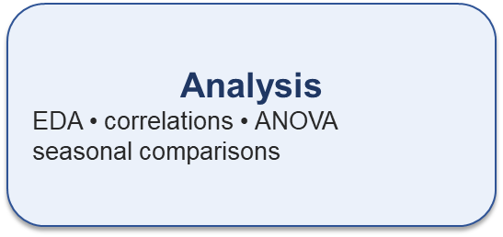
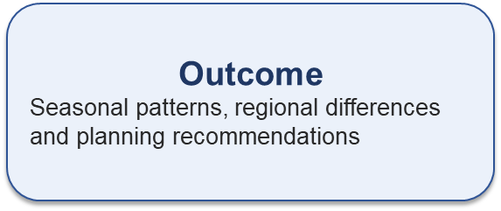
Project Description The project performs an end-to-end analysis of agricultural performance across Kharif, Rabi and Zaid seasons. The dataset is explored and cleaned using Python and Pandas, followed by descriptive analysis, correlation analysis, seasonal comparisons, crop-wise and state-wise analysis, statistical testing and visualizations.
Dataset
4000 records 8 crops • 8 states • 3 seasons

Slide 4

WHO ARE THE END USERS?
Farmers and farm managers – support seasonal crop and resource planning.
Agricultural planners – compare seasonal performance and profitability.
Irrigation and resource managers – monitor water usage and efficiency.
Agricultural analysts and researchers – study seasonal and regional patterns.
Policy and development stakeholders – support evidence-based agricultural planning.

Slide 5

Technology Used
Python – primary programming language for analysis.
Pandas – data loading, cleaning, grouping and aggregation.
NumPy – numerical operations.
Matplotlib and Seaborn – charts, comparisons and heatmaps.
Jupyter Notebook – analysis, documentation and reproducible workflow.
Statistical techniques – correlation analysis and one-way ANOVA.
Visual Studio Code (VS Code) – development environment used to run and manage the Jupyter Notebook

Slide 6
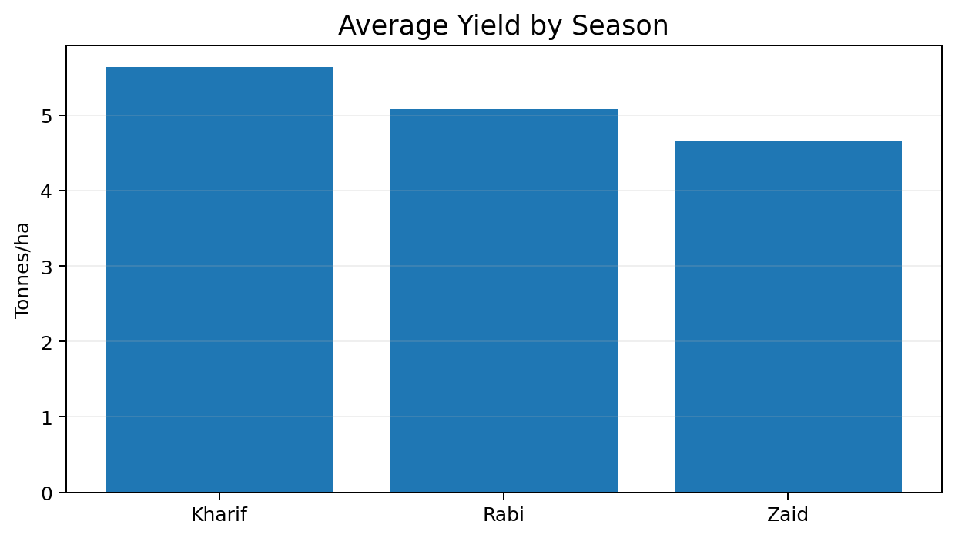
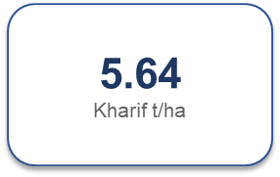
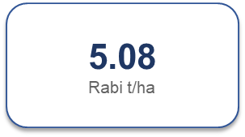
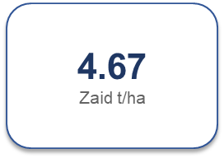
RESULTS – SEASONAL PERFORMANCE
Kharif recorded the highest descriptive average yield.
Rabi ranked second and Zaid ranked third.
Yield ANOVA: p = 0.228.
Seasonal yield differences were not statistically significant at the 5% level.

Slide 7
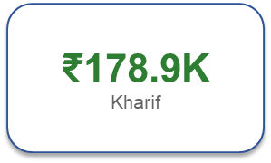
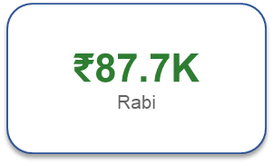
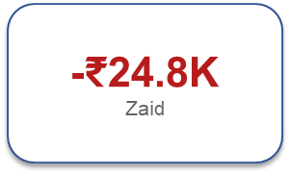
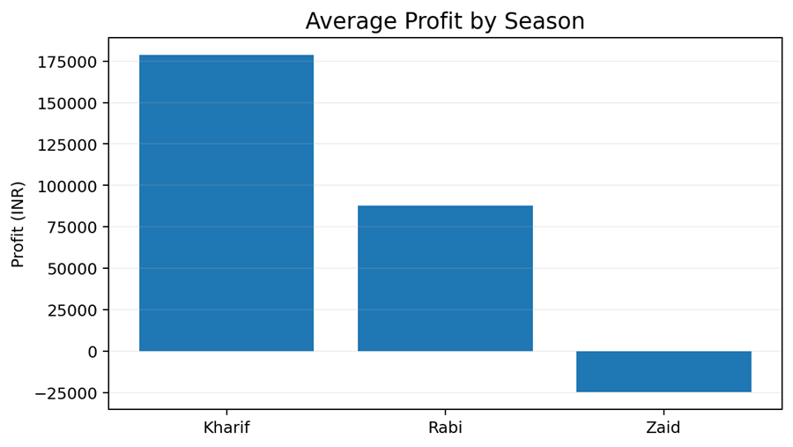
RESULTS – PROFITABILITY & STATISTICAL SIGNIFICANCE
Kharif showed the strongest average profitability.
Zaid recorded an average loss.
Profit ANOVA: F = 34.29, p < 0.001.
Seasonal differences in average profit were statistically significant

Slide 8
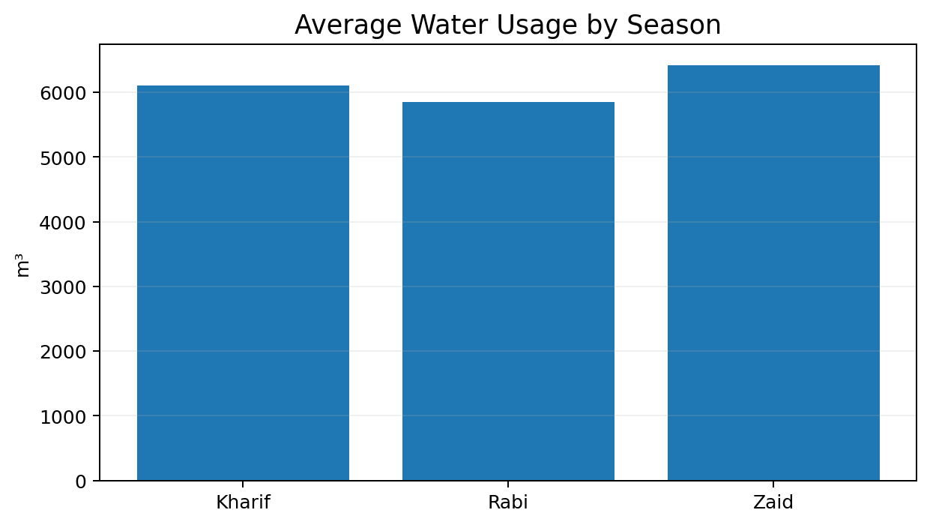
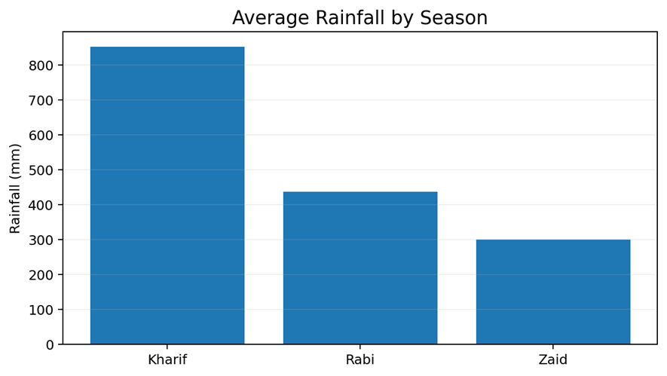
RESULTS – WATER & ENVIRONMENTAL ANALYSIS
Zaid had the highest average water use (6,419.89 m³) and lowest water efficiency (4.41 t/1,000 m³).
Rainfall–yield correlation was close to zero overall; rainfall alone did not strongly explain yield variation

Slide 9
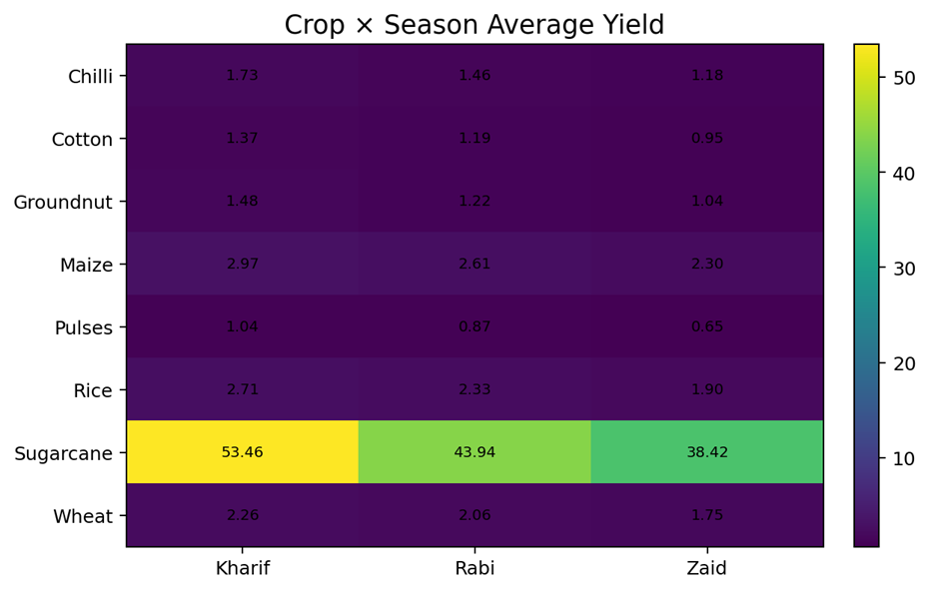
RESULTS - CROP-WISE SEASONAL PERFORMANCE
All eight crops recorded their highest average yield in Kharif, followed by Rabi and Zaid.
Sugarcane had a much higher yield level than the other crops.
Crop-wise production followed the same broad seasonal pattern.
Profitability did not always follow yield or production; several crops showed negative average profit, especially in Zaid.

Slide 10
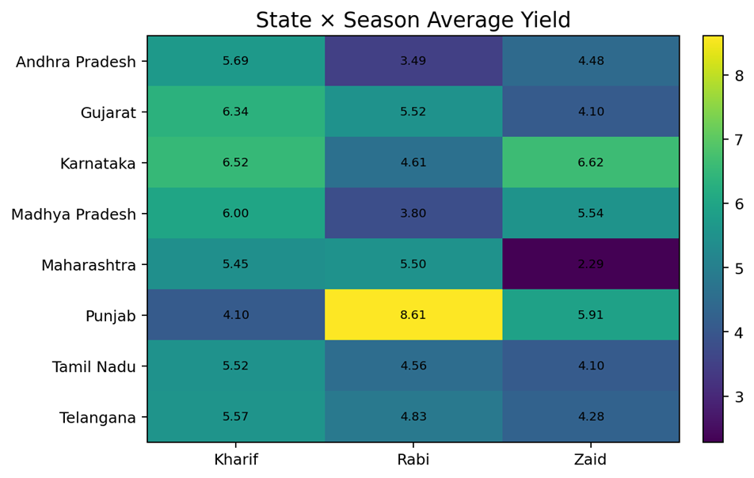
RESULTS – REGIONAL VARIATION & KEY EXCEPTIONS
Seasonal performance was not uniform across states.
Punjab recorded its highest average yield in Rabi (8.61 t/ha).
Karnataka recorded its highest average yield in Zaid (6.62 t/ha).
Regional conditions can change the strongest-performing season.
Overall, Kharif was strong, but regional exceptions are important for planning.

Slide 11
Future scope
Extend the analysis with multi-year agricultural data to study long-term seasonal trends.
Apply machine learning models to predict yield and profitability using multiple factors.
Develop an interactive Power BI/Tableau dashboard for monitoring.
Include market prices, input costs and weather forecasts for stronger economic analysis.
Build region-specific models for localized crop and resource planning.

Slide 12
GitHub Link
https://github.com/adishukla10/Seasonal-Agriculture-Performance-Analysis.git

Slide 13

VOIS Course completion certificate - Course name- Data Visualization

Slide 14
Thank you
.
.

